Slide 1
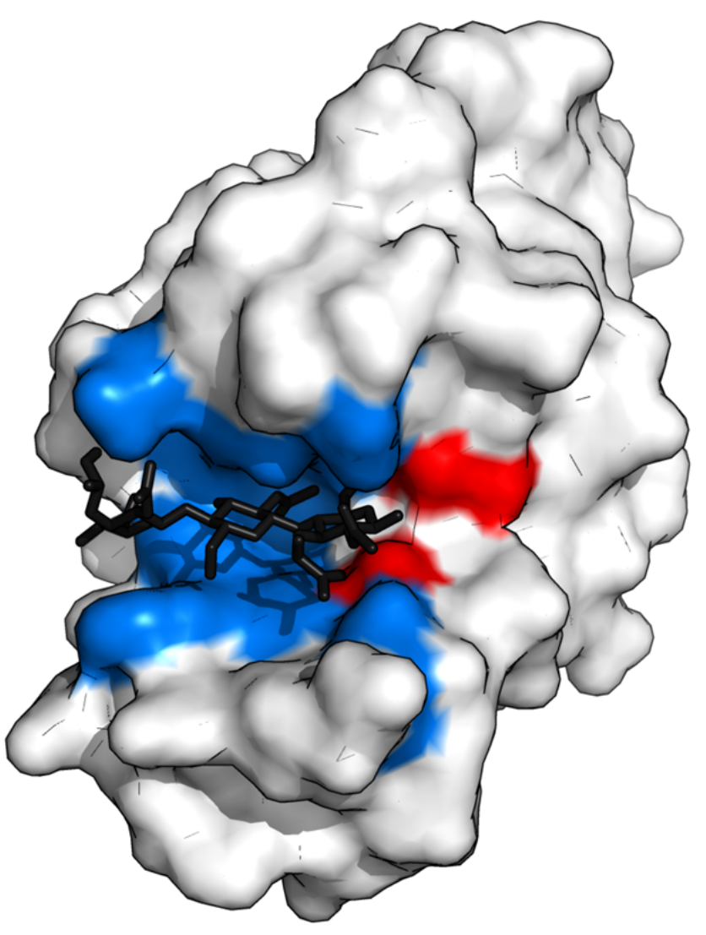
Catalytic Site Annotation with Geometric Deep Learning
Workshop in AI Algorithms for Structural Biology
Project IV | Niv Tenenbaum, Ido Fabian, Sheer Ofer
Advisor: Jerome Tubiana

Slide 2


Background
An essential determinant of the function of a protein is its functional sites, such as catalytic sites, binding sites of other proteins, nucleic acids, lipids, etc.
Annotating these sites sheds light on the function and regulation of proteins, informs the rational design of small molecules or biologics modulators, and guides the interpretation of disease-associated mutants.
Notes:
עידו

Slide 3
Examining single protein
Identify Binding Sites: A Binding region often overlaps with a catalytic site.
Site-Directed Mutagenesis: Mutate specific amino acids and test activity-reduced activity points to a crucial catalytic residue.
Structural Analysis: Examine the protein's 3D structure - pockets or grooves suggest potential active site location.
Chemical Modification: Modify amino acid side chains and observe activity changes - essential catalytic residues become evident.
Notes:
ניב
שיטות לזיהוי אתר קטליטי ברמת חלבון בודד

Slide 4
Examining multiple proteins
With the increasing number of identified protein 3D structures, it is highly desirable to develop an efficient method to identify their catalytic sites.
Databases of catalytic sites exist, but no deep learning-based predictor has been developed so far.
Sequence Analysis: Compare protein sequence to known enzymes - conserved regions hint at catalytic sites.
Machine learning models built on top of handcrafted features and comparative modeling. They are, respectively, limited by the expressivity of the handcrafted features and the availability of similar proteins.
Notes:
שיר
שיטות לזיהוי אתר קטליטי באופן רחב בהרבה חלבונים
With the increasing number of protein 3D structures having been solved by X-ray crystallography and NMR techniques, it is highly desirable to develop an efficient method to identify their catalytic sites.

Slide 5
ScanNet (Spatio-Chemical Arrangement of Neighbors Network)
An interpretable geometric deep learning model for structure-based protein binding site prediction | Tubiana, J., Schneidman-Duhovny, D. & Wolfson, H.J.
ScanNet builds representations of atoms and amino acids based on the spatio-chemical arrangement of their neighbors.
ScanNet predictions integrate information from multiple scales (atom, amino acid) and modalities (structure, multiple sequence alignment (MSA).
It detects simple, generic structural motifs such as hydrogen bonds or solvent-exposed hydrophobic side-chains. (unlike comparative modeling or handcrafted features models)
Notes:
ניב
הסבר כללי על המודל שלו
Geometric Deep Learning is a niche in Deep Learning that aims to generalize neural network models to non-Euclidean domains such as graphs and manifolds.
Originally trained for detecting protein’s binding sites.
Currently, two classes of methods prevail: machine learning models built on top of handcrafted features (limited by the expressivity of the handcrafted features) and comparative modeling (limited by the availability of similar proteins.
Point clouds, graphs and surfaces can be analyzed via geometric deep learning, that is, end-to-end differentiable models tailored for data with no natural grid-like topology or shared global coordinate system. Graphs can be derived from 3D structures by taking residues as nodes and the distances and angles between them as edges and processed using graph neural networks (GNN) such as message passing neural networks or graph attention networks. By design, GNNs are invariant on Euclidean transformation and expressive, but can be challenging to regularize and interpret
ScanNet builds representations of atoms and amino acids based on the spatio-chemical arrangement of their neighbors and exploits them to predict labels for each amino acid. By construction, ScanNet is end-to-end differentiable with minimal structure preprocessing, yielding fast training and inference. ScanNet predictions are local, invariant on Euclidean transformations and integrate information from multiple scales (atom, amino acid) and modalities (structure, multiple sequence alignment (MSA))
The network detects simple, generic structural motifs, whereas others recognize complex, task-specific motifs such as hotspot O-rings or transmembrane helixes.

Slide 6
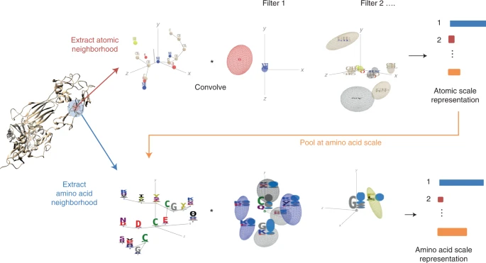
Notes:
ScanNet inputs are the primary sequence, tertiary structure and, optionally, position–weight matrix computed from a MSA of evolutionarily related proteins. First, for each atom, neighboring atoms are extracted from the structure and positioned in a local coordinate frame (top left). The resulting point cloud is passed through a set of trainable, linear filters detecting specific spatio-chemical arrangements (top middle), yielding an atomic-scale representation (top right). After aggregation of the atomic representation at the amino acid level and concatenation with amino acid attributes, the process is reiterated with amino acids to obtain a representation of an amino acid (bottom). The latter is projected and locally averaged for residue-wise classification

Slide 7
Milestones
Collect the database of Catalytic Site Atlas and parse it into a training-compatible format.
Combine the catalytic dataset with all the amino acids in the relevant proteins and create a binary vector according to catalytic/non-catalytic residue.
Create a SCC graph based on CATH Id, to find homology between proteins.
Split the data into 3 independent groups - train, test, and validation. - validation intended to prevent overfitting
Notes:
שיר
CATH is a hierarchical classification of protein domain structures, which clusters proteins at four major levels, Class(C), Architecture(A), Topology(T) and Homologous superfamily (H). It provides information on the evolutionary relationships of protein domains

Slide 8
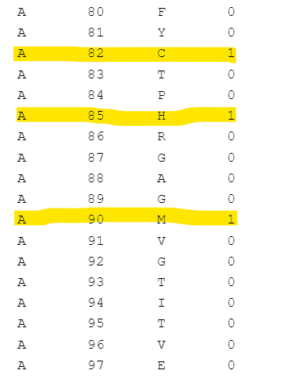
Our Data
1115 proteins - only chains with catalytic annotation
448 components (by CATH Id)
Train – 60%, Test – 20%, validation – 20%
Notes:
82 – Cystein
85 – Histidine
90 - Methionine

Slide 9
Milestones
5. Training of the network - we used a pre-train model instead of training it from scratch
6. Prediction on the test set
7. Drawing the Precision-recall curve and evaluating the performance
Notes:
עידו
להתייחס לזה שהשתמשנו במודל שכבר אימנו בעבר על binding site (ולא לקחנו מודל ואימנו אותו מאפס)

Slide 10
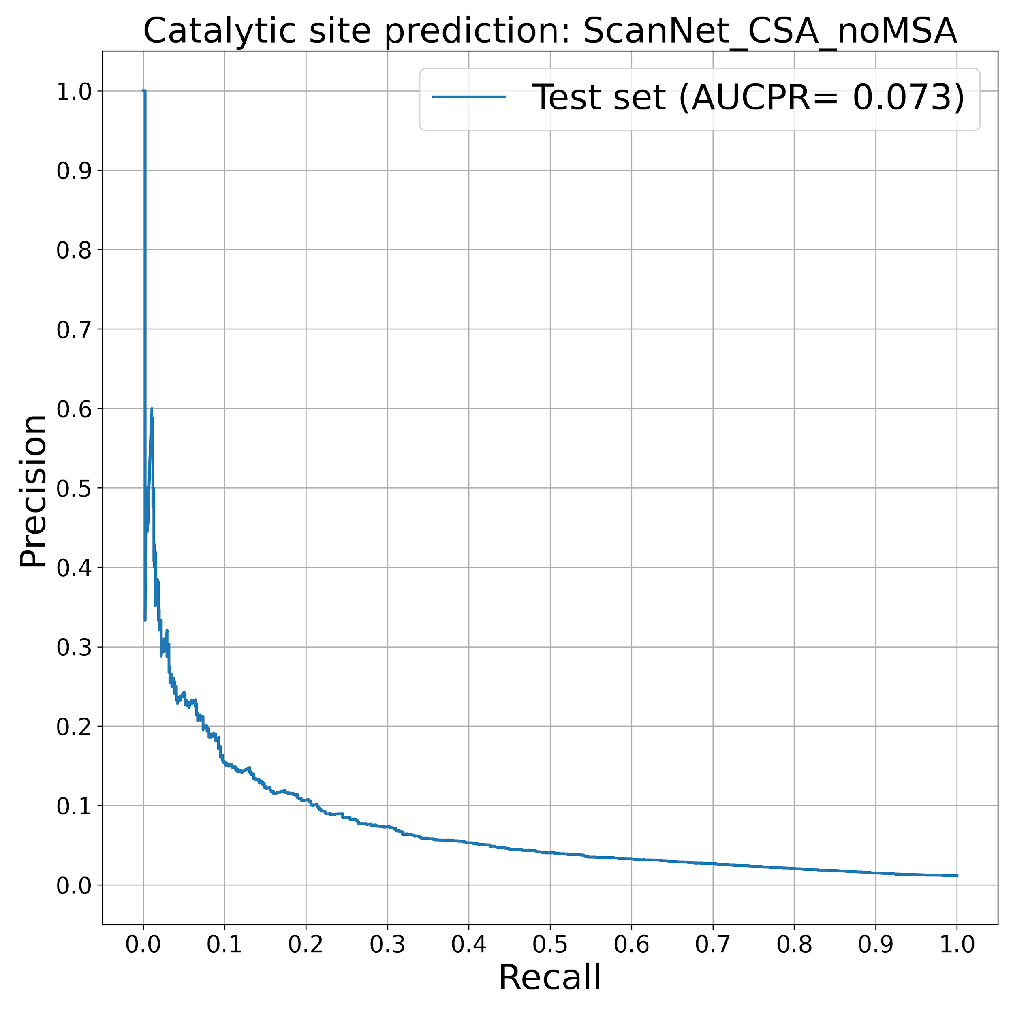
Precision-recall curve
Notes:
The precision-recall curve shows the tradeoff between precision and recall for different threshold. A high area under the curve represents both high recall and high precision, where high precision relates to a low false positive rate, and high recall relates to a low false negative rate. High scores for both show that the classifier is returning accurate results (high precision), as well as returning a majority of all positive results (high recall).
Jerome email:
1/ First of all, the PR curve you sent is not very good but not that bad. The fraction of positive labels is very low in your dataset (about 1-2% judging from the curve). The AUCPR of a null model that assigns a random probability to each amino acid is 0.01/0.02. In other words, you are doing significantly better than random. You can check for instance that if you do not fine tune your model at all (set freeze=True), the AUCPR will be lower.

Slide 11
Protein Trypsin Prediction
Model | Chain | Residue Index | Sequence | Catalytic site probability
0 | A | 192 | Q | 0.052
0 | A | 102 | D | 0.05
0 | A | 195 | S | 0.038
0 | A | 220 | C | 0.031
0 | A | 189 | D | 0.03
0 | A | 191 | C | 0.03
0 | A | 143 | N | 0.029
0 | A | 55 | A | 0.027
0 | A | 73 | I | 0.026
0 | A | 57 | H | 0.025
0 | A | 142 | G | 0.025
0 | A | 219 | G | 0.023
Notes:
The precision-recall curve shows the tradeoff between precision and recall for different threshold. A high area under the curve represents both high recall and high precision, where high precision relates to a low false positive rate, and high recall relates to a low false negative rate. High scores for both show that the classifier is returning accurate results (high precision), as well as returning a majority of all positive results (high recall).
Tyrasin

Slide 12
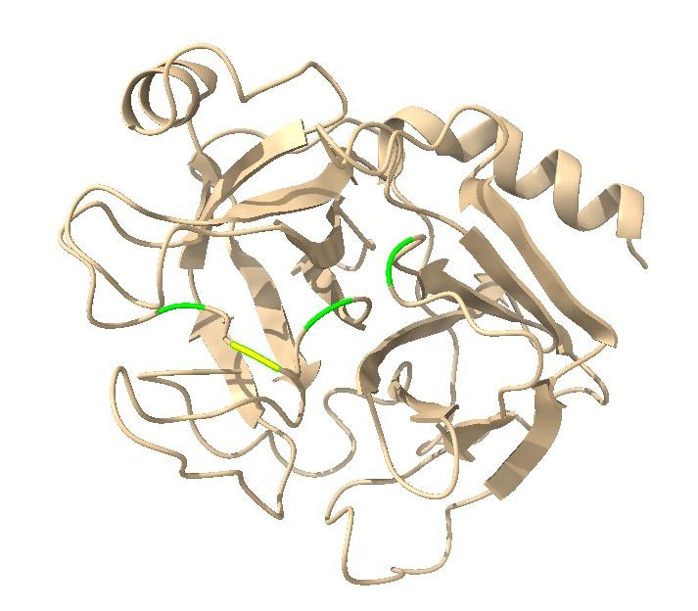
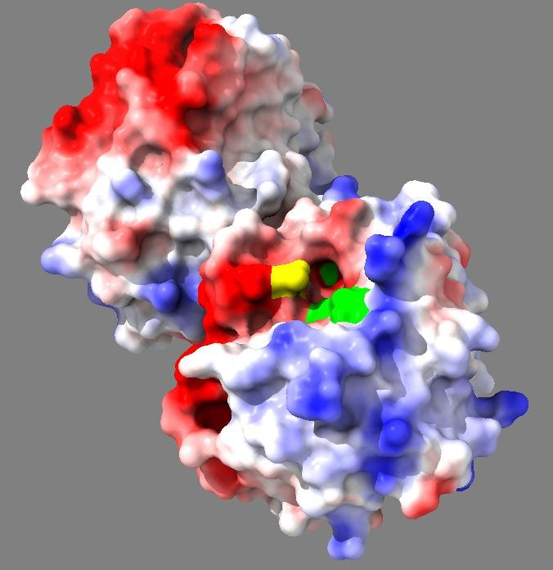
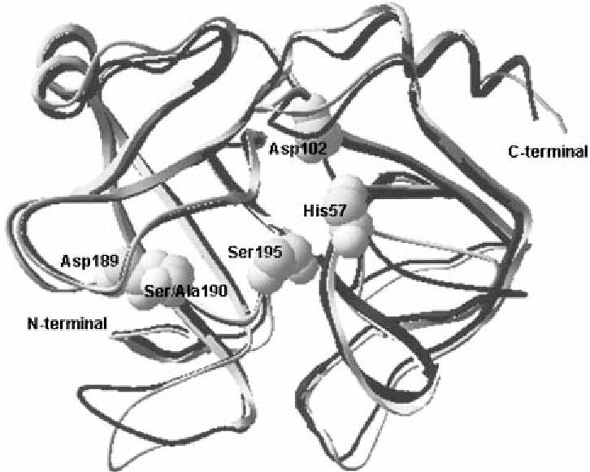
Protein Trypsin Prediction
Out of our top 10 predicted position to be catalytic, 5 residues are real catalytic sites!
Notes:
The precision-recall curve shows the tradeoff between precision and recall for different threshold. A high area under the curve represents both high recall and high precision, where high precision relates to a low false positive rate, and high recall relates to a low false negative rate. High scores for both show that the classifier is returning accurate results (high precision), as well as returning a majority of all positive results (high recall).
Tyrasin

